Slide 1


STUDENT INTERNSHIP PROGRAM
We provide students with out of classroom trainings, mentorship and direct industry experience .

Slide 2
E.I.M Learning and Development Consult is a management consultancy whose main focus is to provide corporate institutions and organizations with well qualified and professional Interns. Our Interns, are paired with mentors who are drawn from across the globe, who guide them on their duties thereby ensuring organizational growth and development to any institution privileged to hire them. We also provide High end trainings to Employees of our partners to keep them update with growing industry trends.
- About us

Slide 3
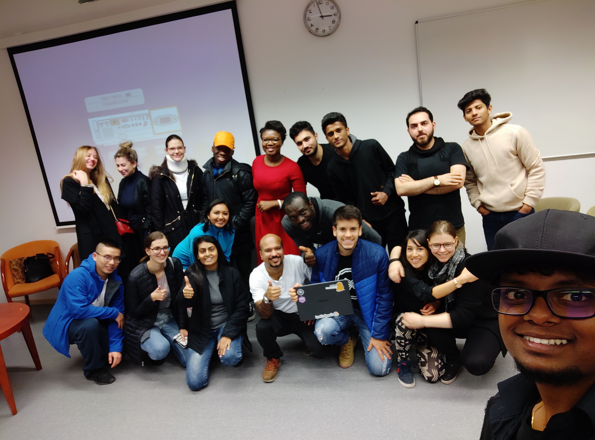
STUDENT INTERNSHIP PROGRAM PLACEMENT
The E.I.M learning & development student internship program is a proud newly created 2/3 months program designed to provide students with out of classroom experience, mentorship and firsthand industry experience
At the end of the traineeship, interns combine work-based training with an employer and formal training from a training provider.
E.I.M seeks bring together students who want internship placements, job owners and hiring managers.

Slide 4
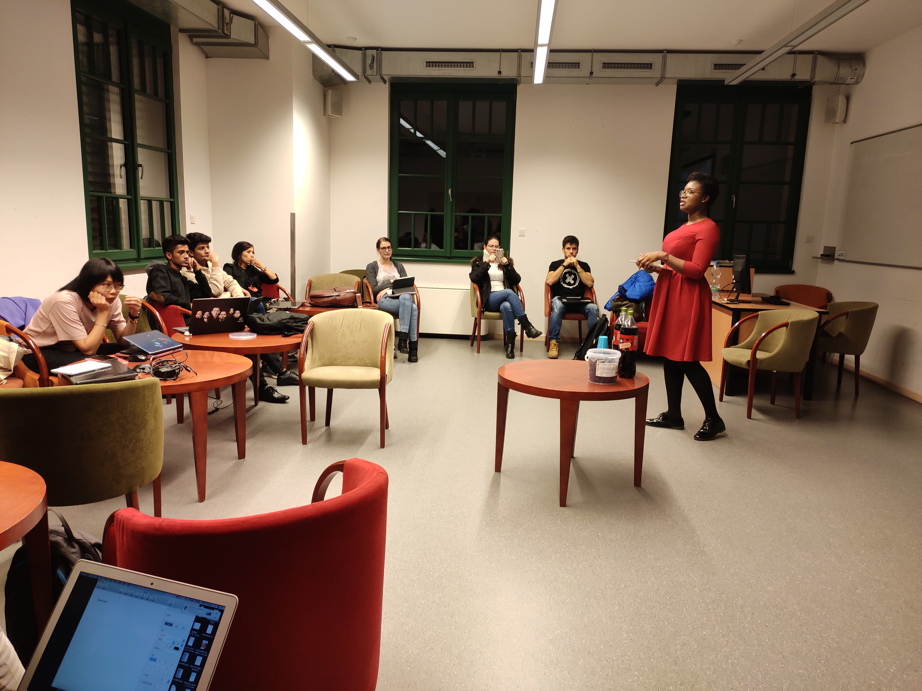
STUDENT INTERSHIP PROGRAM CON’T
Our programs cover topics on
Personal Branding
Public speaking, Communication & Presentation skills
CV Writing
Identifying opportunities
Minute & Proposal Writing
Basic Microsoft Package Skills

Slide 5

PLACEMENT SLOTS
To feasibly attain this goal, we will like to partner with your organization for a placement slots in order to provide our students a complete experience through an internship with your organization. This internship comes at no cost to your organization

Slide 6
PLACEMENT SLOTS CON’T
In a way of expressing our appreciation, your organization's logo will be displayed on all communication materials for the forum including; websites, social media and print publications . This will affirm clearly your support for millennials and enhance your goodwill to the general public.
The attached form in the subsequent page allows you to specify your commitment .

Slide 7
AGREEEMENT FORM
Name of Organization: ____________________________________________________________________________________
Number of Slots: ___________________________________________________________________________________________
Departments: _______________________________________________________________________________________________
Relevant competencies: ____________________________________________________________________________________
______________________________________________________________________________________________
Preferred Schools:______________________________________________________________________________________________________________________________________________________________________________________
AUTHORIZING OFFICER
Name:______________________________________________________________________________________________________________________________
Designation:___________________________________________________________________________________________

Slide 8
CONTACT
EMAIL
MOBILE
WEBSITE
eimconsultld@gmail.com
+233273330992
www.eimafrica.com

